Slide 1


Slide 2
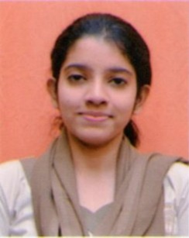
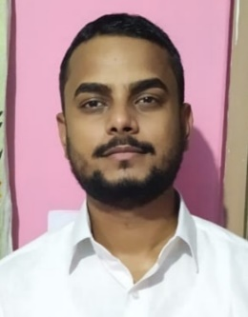
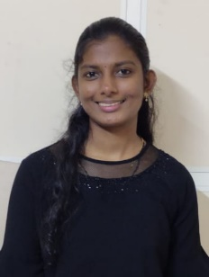
Project Highlights
Project Name : Student Management
Team Size : 03
BU Mentor Name : Mentor PS#
Team Members Details (Professional Stamp Size Photo with few lines of individual briefing
Angana Dawn
PS#
2009MYSSPSB1
B.E
Html,css,c#,javascript python
Rahul Rauniyar
99002600
2009MYSSPSB1
B.TECH
Html,css,c#,javascript
Binitta Michael
99002637
2009MYSSPSB1
B.TECH
C,python,html,css

Slide 3
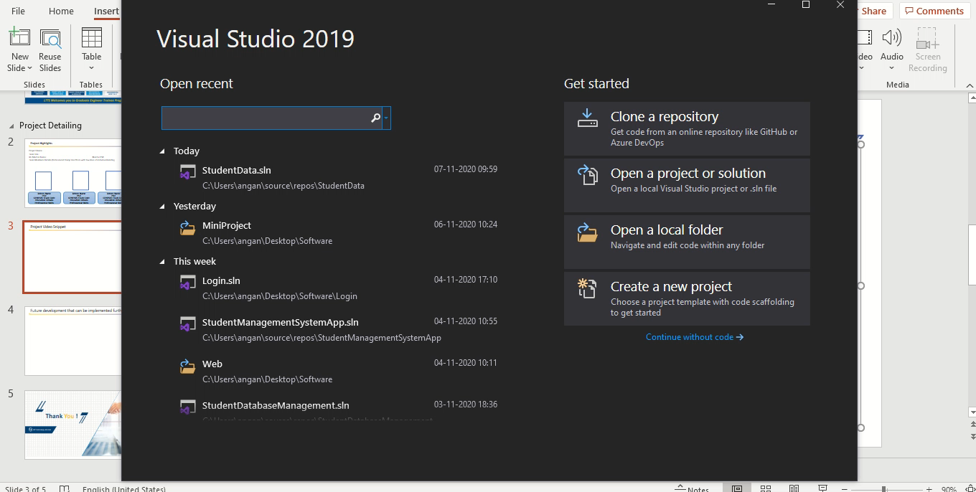
Project Video Snippet

Slide 4
Future development that can be implemented further
Admin can access the data of the student.
They can change ,edit and view the details of the student.
Admin can add the content and facilities available.
Can also publish the result online where student can see it easily.
Plan for more and good events.

Slide 5


Thank You !

